Slide 1
Driver Drowsiness Detection System with OpenCV & Keras
CAPSTONE PROJECT
Presented By:
BATTULA CHAKRADHAR
Krishna Chaitanya Institute of Technology & Sciences
Department of Artificial Intaligence & Machine Learning

Slide 2
OUTLINE
Problem Statement (Should not include solution)
Proposed System/Solution
System Development Approach (Technology Used)
Algorithm & Deployment
Result
Conclusion
Future Scope
References

Slide 3
Problem Statement
Drowsiness detection is a safety technology that can prevent accidents that are caused by drivers who fell asleep while driving.
The objective of this project is to build a drowsiness detection system that will detect that a person’s eyes are closed for a few seconds. This system will alert the driver when drowsiness is detected.

Slide 4
Proposed Solution
In this Python project, we will be using OpenCV for gathering the images from webcam and feed them into a Deep Learning model which will classify whether the person’s eyes are ‘Open’ or ‘Closed’. The approach we will be using for this Python project is as follows :
Step 1 – Take image as input from a camera.
Step 2 – Detect the face in the image and create a Region of Interest (ROI).
Step 3 – Detect the eyes from ROI and feed it to the classifier.
Step 4 – Classifier will categorize whether eyes are open or closed.
Step 5 – Calculate score to check whether the person is drowsy.
The dataset(Driver Drowsiness Dataset) is used for this model is created by us. The data comprises around 7000 images of people’s eyes under different lighting conditions. After training the model on our dataset, we have attached the final weights and model architecture
Now, you can use this model to classify if a person’s eye is open or closed.
The Model Architecture
The model we used is built with Keras using Convolutional Neural Networks (CNN). A convolutional neural network is a special type of deep neural network which performs extremely well for image classification purposes.
The CNN model architecture consists of the following layers:
2 Convolutional layer; 32 nodes, kernel size 3
1 Convolutional layer; 64 nodes, kernel size 3
1 Fully connected layer; 128 nodes
The final layer is also a fully connected layer with 2 nodes. A Relu activation function is used in all the layers except the output layer in which we used Softmax.

Slide 5
System Approach
System requirements
The requirement for this project is a webcam through which we will capture images. You need to have Python (3.6 version recommended) installed on your system, then using pip, you can install the necessary packages.
Library required to build the model
OpenCV – pip install opencv-python (face and eye detection).
TensorFlow – pip install tensorflow (keras uses TensorFlow as backend).
Keras – pip install keras (to build our classification model).
Pygame – pip install pygame (to play alarm sound).

Slide 6
Algorithm & Deployment
Let’s now understand how our algorithm works step by step.
Step 1 – Take Image as Input from a Camera
With a webcam, we will take images as input. So to access the webcam, we made an infinite loop that will capture each frame. We use the method provided by OpenCV, cv2.VideoCapture(0) to access the camera and set the capture object (cap). cap.read() will read each frame and we store the image in a frame variable.
Step 2 – Detect Face in the Image and Create a Region of Interest (ROI)
To detect the face in the image, we need to first convert the image into grayscale as the OpenCV algorithm for object detection takes gray images in the input. We don’t need color information to detect the objects. We will be using haar cascade classifier to detect faces. This line is used to set our classifier face = cv2.CascadeClassifier(‘ path to our haar cascade xml file’). Then we perform the detection using faces = face.detectMultiScale(gray). It returns an array of detections with x,y coordinates, and height, the width of the boundary box of the object. Now we can iterate over the faces and draw boundary boxes for each face.
Step 3 – Detect the eyes from ROI and feed it to the classifier
The same procedure to detect faces is used to detect eyes. First, we set the cascade classifier for eyes in leye and reye respectively then detect the eyes using left_eye = leye.detectMultiScale(gray). Now we need to extract only the eyes data from the full image. This can be achieved by extracting the boundary box of the eye and then we can pull out the eye image from the frame with this code.
l_eye only contains the image data of the eye. This will be fed into our CNN classifier which will predict if eyes are open or closed. Similarly, we will be extracting the right eye into r_eye.

Slide 7
Algorithm & Deployment
Step 4 – Classifier will Categorize whether Eyes are Open or Closed
We are using CNN classifier for predicting the eye status. To feed our image into the model, we need to perform certain operations because the model needs the correct dimensions to start with. First, we convert the color image into grayscale using r_eye = cv2.cvtColor(r_eye, cv2.COLOR_BGR2GRAY). Then, we resize the image to 24*24 pixels as our model was trained on 24*24 pixel images cv2.resize(r_eye, (24,24)). We normalize our data for better convergence r_eye = r_eye/255 (All values will be between 0-1). Expand the dimensions to feed into our classifier. We loaded our model using model = load_model(‘models/cnnCat2.h5’) . Now we predict each eye with our model
lpred = model.predict_classes(l_eye). If the value of lpred[0] = 1, it states that eyes are open, if value of lpred[0] = 0 then, it states that eyes are closed.
Step 5 – Calculate Score to Check whether Person is Drowsy
The score is basically a value we will use to determine how long the person has closed his eyes. So if both eyes are closed, we will keep on increasing score and when eyes are open, we decrease the score. We are drawing the result on the screen using cv2.putText() function which will display real time status of the person.
A threshold is defined for example if score becomes greater than 15 that means the person’s eyes are closed for a long period of time. This is when we beep the alarm using sound.play()

Slide 8
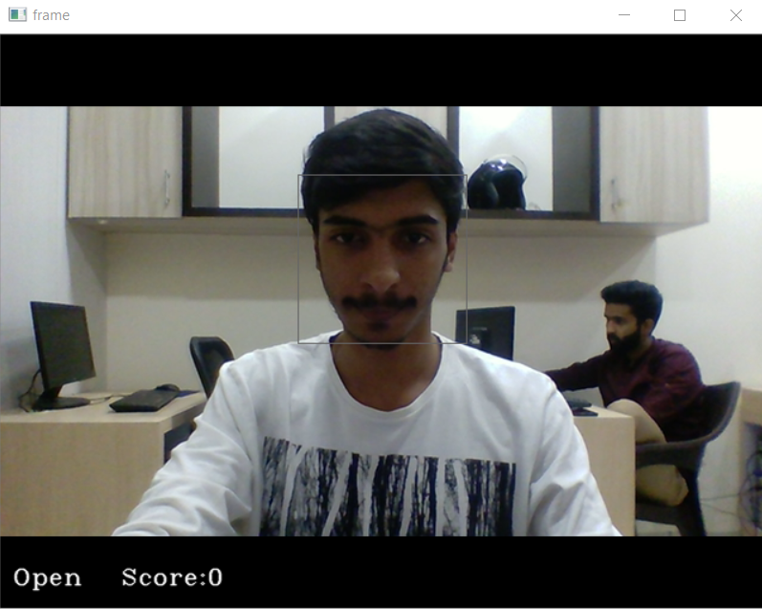
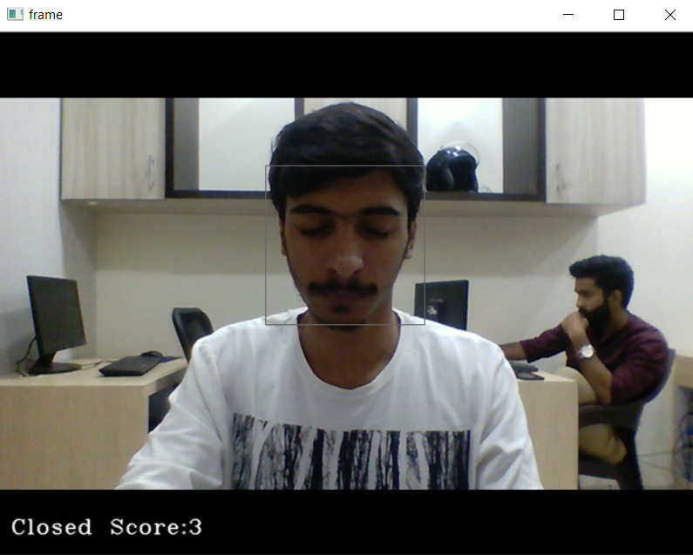
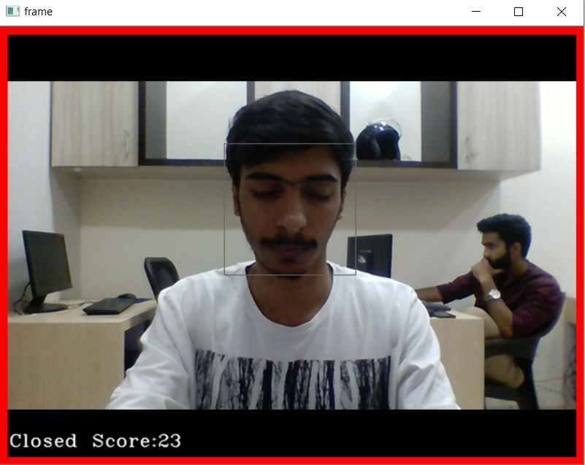
Result

Slide 9
Conclusion
In this project, we have built a drowsy driver alert system that you can implement in numerous ways. We used OpenCV to detect faces and eyes using a haar cascade classifier and then we used a CNN model to predict the status.
The system which can differentiate normal eye blink and drowsiness can prevent the driver from entering the state of sleepiness while driving. The system works well irrespective of driver wearing spectacles and under low light conditions also.

Slide 10
Future scope
The purpose of the drowsiness detection system is to aid in the prevention of accidents passenger and commercial vehicles. The system will detect the early symptoms of drowsiness before the driver has fully lost all attentiveness and warn the driver that they are no longer capable of operating the vehicle safely.
Once the eyes are located, measuring the intensity changes in the eye area determine the eyes are open or closed. If the eyes are found closed for 4 to 5 consecutive frames, it is confirm that the driver is in drowsiness condition. Drowsiness is a state of near sleep, where the person has a strong desire for sleep.
The proposed model achieved an accuracy of 84% in detecting driver drowsiness. Finally, the study concluded that the proposed system could be used as a part of a driver monitoring system to improve road safety.

Slide 11
References
Here is the Drive link of resoures that I have been used in this project
https://drive.google.com/file/d/1zodAMJQFuqThN3sKQ9Bcb76gUSFIMPrG/view
The Drowsiness Detection Dataset is generated using MRL and Closed Eyes in Wild(CEW) dataset, as well as our own unique dataset. This large-scale dataset comprising of both closed and open human eye images can be majorly used for eye detection and further be extended for drowsiness detection.
To identify drowsy driving, the researcher primarily focuses on eye blink rate and percentage of eye closure (PERCLOS), which are further examined by machine learning (ML) and deep learning (DL) algorithms

Slide 12

course certificate 1

Slide 13

course certificate 2

Slide 14
THANK YOU

